Slide 1
Image Classifier for Tropical Flower Identification
By Daren Tan
DSI-SG-27
Notes:
Welcome to my capstone project presentation, in which I try to build an image classifier to identify tropical plants

Slide 2





Problem Statement
The most popular plant identification apps on the market have low accuracy on local plants
Create an image classifier that is more tailored to local flora
Notes:
Personal project
Multiple apps but not very accurate
Try a build a better image classification model just for local plants that could eventually be used in a similar app
To provide accessible education on local plants and plantcare

Slide 3


Data Gathering
External research for class selection
253 most popular plant species in Singapore
Selenium WebDriver to scrape Google Images
100 images per species
Looking for photos, but found images
Notes:
Use a WebDriver API called Selenium
simulated the process of searching for images of flowers and downloading them

Slide 4
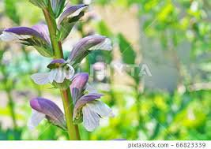
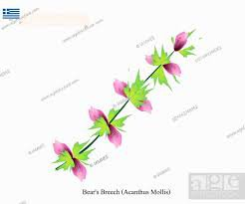
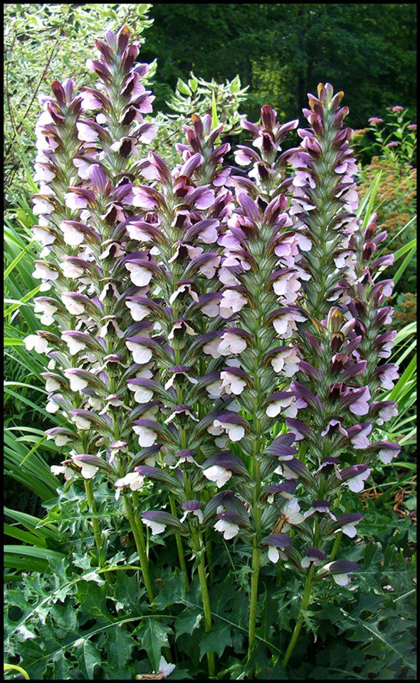
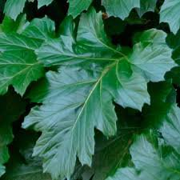


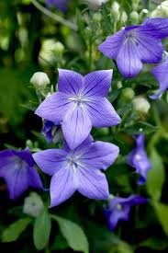
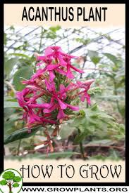
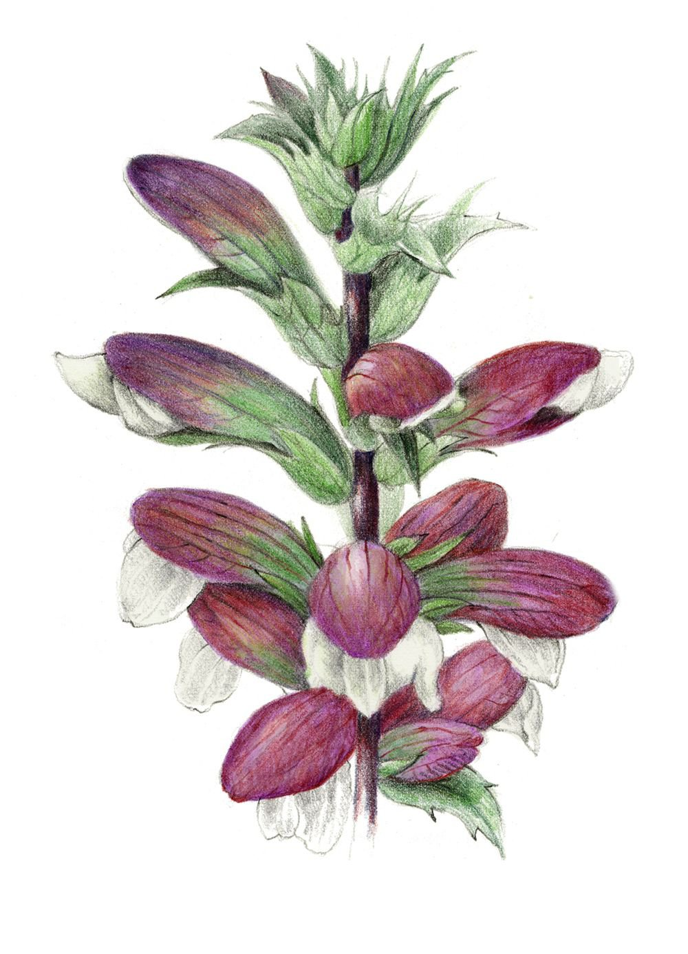
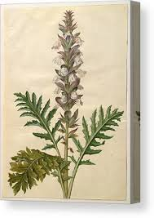
EDA
Dirty data
Stock photos
Photos with watermarks
No subject in frame
Collages
Photos with frames
Diagrams or sketches
Wrongly labeled
Duplicates
Notes:
A lot of dirty data
Acanthus
Features that would confuse the neural network

Slide 5

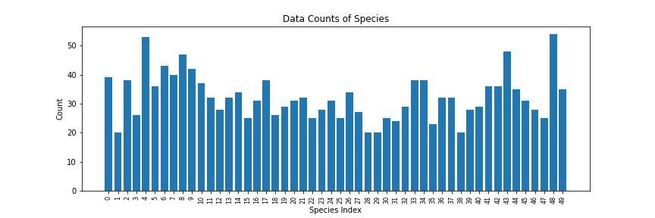
Data Cleaning
Manually cleaned each class
Between 20 - 60% of images of some classes were inappropriate
Some obscure species had to be removed due to lack of quality photographs
Narrowed classification problem down from 253 classes to 50 classes
Due to cleaning, final dataset entailed 2597 images over 50 classes
Notes:
Scraped slightly cleaner data with search params
Still lot of cleaning
No significant imbalances

Slide 6
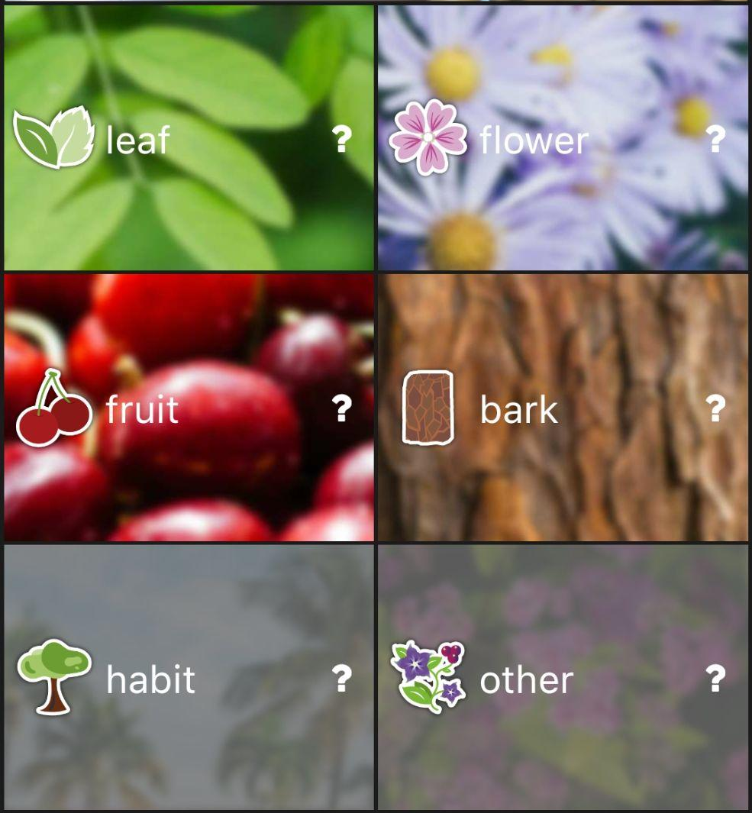
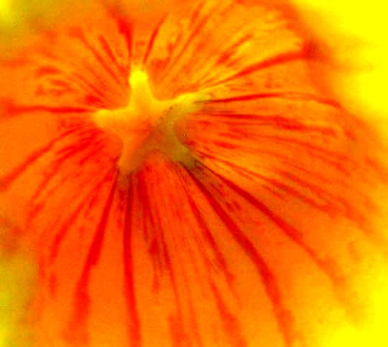
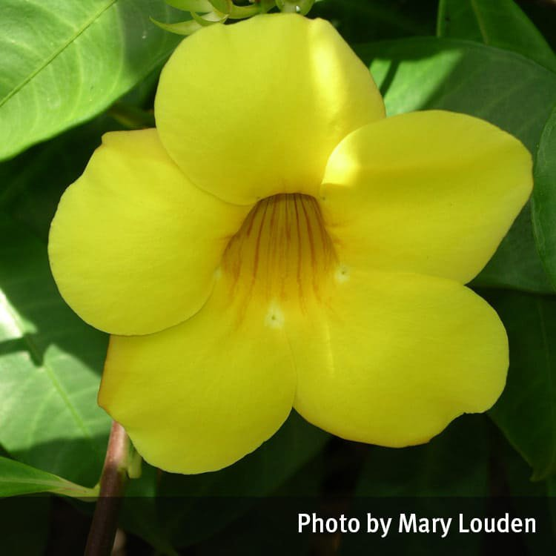
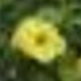
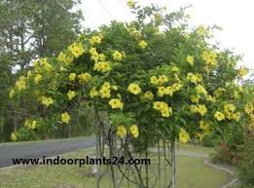
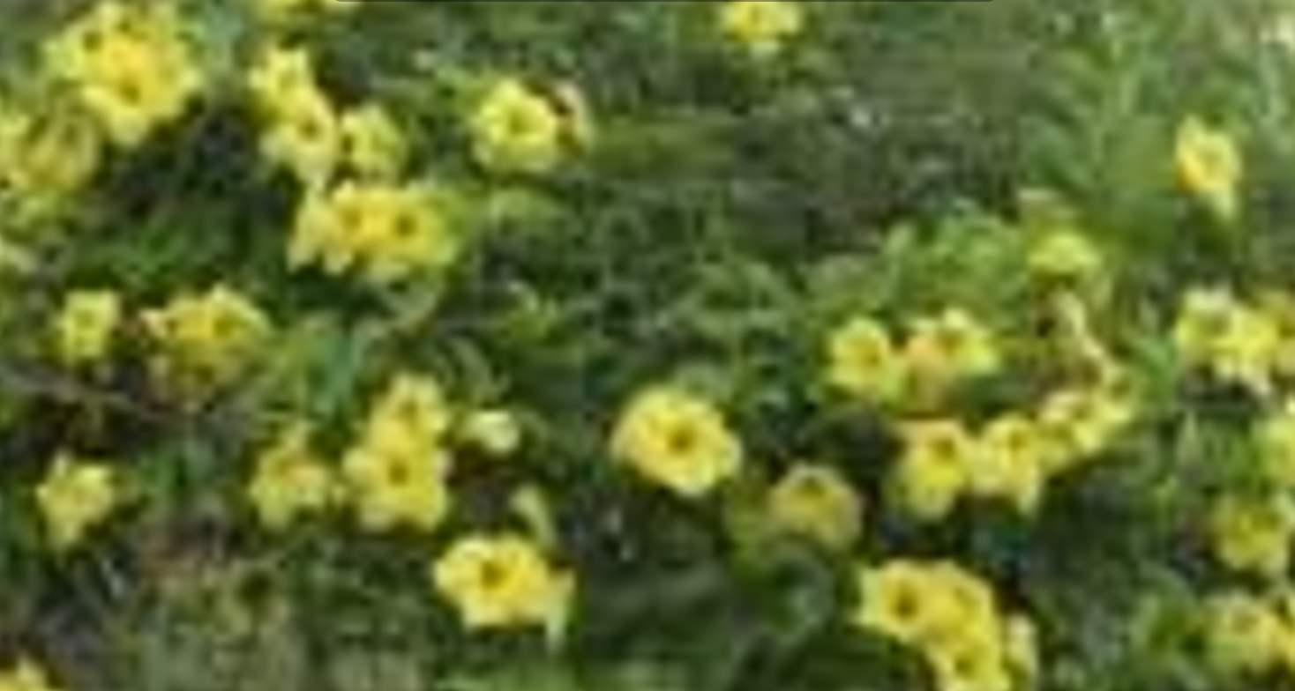
Data Cleaning+
Scale variation particularly troublesome as largely single flowers used in our dataset
Cluster flowers and zoomed-out photos ((plants) are a problem
Notes:
What we noticed mid-way through this project is there is a particular issue with scale-variation as zooming too far out would introduce different features
3 flowers of different scale/zoom level
Middle photo is ideally what we want
Last photo is not ideal since it is too dissimilar to what we are looking to classify even though there are flowers there
In fact, the more we zoom in*click*, the more useful it would be to our dataset despite losing resolution
We will see this issue crop up later because some flowers naturally grow in clusters and due to the scarcity of the dataset
What we could eventually do to solve this is the Pl@ntNet solution*click*, where they allow the user to choose which part of the plant they are taking a photo of

Slide 7
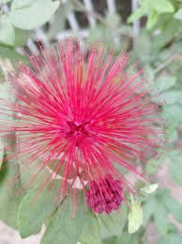
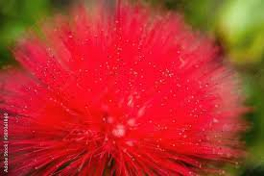
Assumption
Each photo that has been pulled has been verified to be correctly classified
Model will have to account for slight variations in similar images
calliandra_tergemina_flower
calliandra_haematocephala_flower
Notes:
Each image will have been classified twice
Google (dumb)
Myself verifying
However, lots of different species, many of which can look very similar, so difficult to be certain that I verified correctly

Slide 8
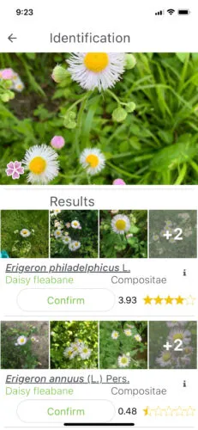
Models Tested
CPU: AMD EPYC Processor (with IBPB) (92 core)
RAM: 1.7T
GPU: Tesla A100
Batch size: 32
Source: https://keras.io/api/applications/
Model | Size (MB) | Top-1 Accuracy | Top-5 Accuracy | Parameters | Depth | Time (ms) per inference step (CPU) | Time (ms) per inference step (GPU)
VGG-19 | 549 | 71.3% | 90.0% | 143.7M | 19 | 84.8 | 4.4
InceptionV3 | 92 | 77.9% | 93.7% | 23.9M | 189 | 42.2 | 6.9
MobileNetV2 | 14 | 71.3% | 90.1% | 3.5M | 105 | 25.9 | 3.8
EfficientNetB3 | 48 | 81.6% | 95.7% | 12.3M | 210 | 140.0 | 8.8
Notes:
For efficiency’s sake, we looked at using pre-trained models rather than training our own from scratch.
The 4 models that we considered were: VGG-19, InceptionV3, MobileNetV2, and EfficientNetB3.
The table shown here lists the characteristics of each model, and their performance on the ImageNet validation data while running on the same hardware.
VGG-19
Improved version of VGG-16, benchmark for pre-trained models.
Architecture is familiar to basic CNN models
InceptionV3
Strong-performing CNN, more accurate than VGG-19
More GPU-intensive, which tends to be the limiting factor in most machines
MobileNetV2
Another high-performance model
Small size, and very low demands on the CPU and GPU
EfficientNetB3
One of the best-performing models in the keras applications library
But Also the most computationally taxing
Metrics
Top-1 Accuracy & Top-5 Accuracy
Both important
Top-1 Accuracy or just accuracy doesn’t have to be explained
Top-5 acc is the probability that the plant to be identified is within the Top-5 predictions of the model
Top-5 is useful as an app can still aid the user in identifying the plant by giving suggestions like a recommender system *click*
This is an example of Pl@ntNet suggesting other plans that look similar to what the user has taken a photo of

Slide 9
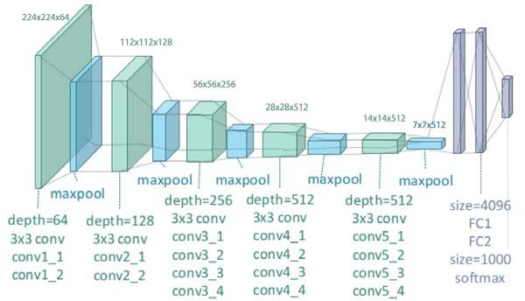
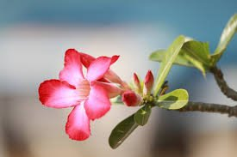
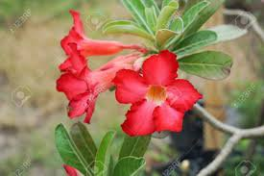
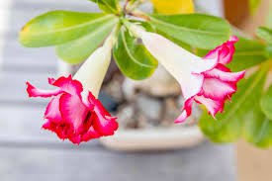
Model Architecture (VGG-19)
Notes:
In order to compare the individual performance of each of these pre-trained models on our flower dataset, we froze all of the layers and replaced the final fully-connected output layer with our own. For example, in this case of the VGG-19 architecture, the final output layer would have 1000 classes, but we would replace it with our own layer of 50 classes to make it suitable for our purposes

Slide 10
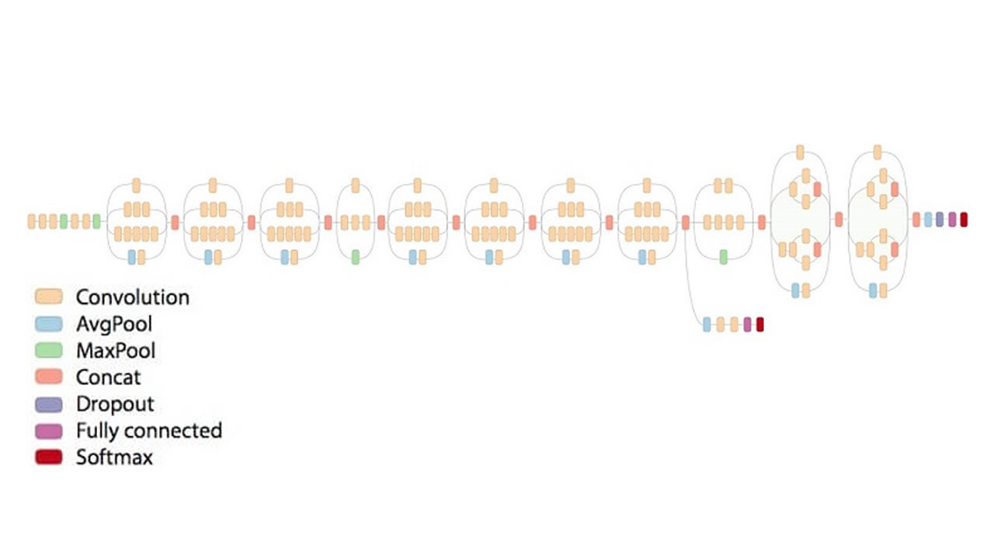
Model Architecture (InceptionV3)

Slide 11
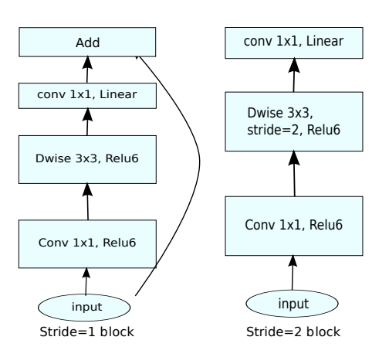
Model Architecture
(MobileNetV2)

Slide 12
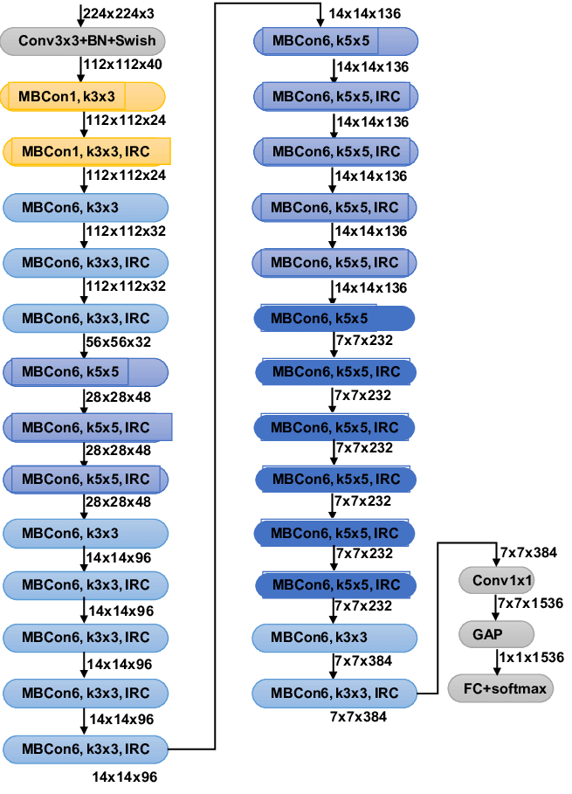
Model Architecture
(EfficiencyNetB3)

Slide 13
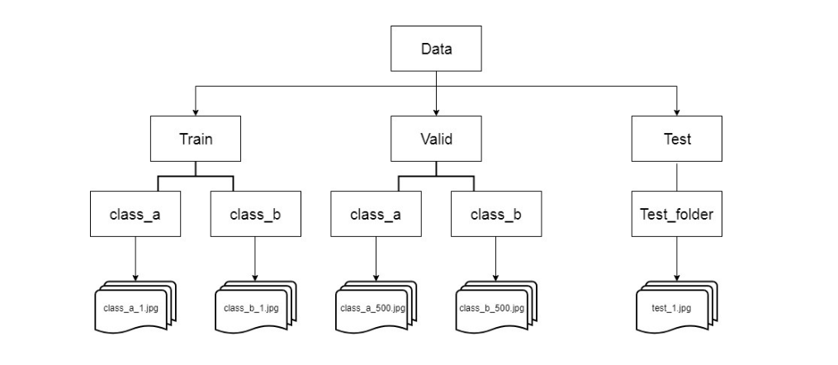
Data Set-Up
Train-val-test split
80-20-20
2597
1615
426
538
Notes:
80-20-20 split
For example *click*
Our dataset is around 2600 images large
And so it will split like this (click)
What this does is:
Training data
Train the model
Validation data
Validate model performance and tune hyperparameters
Testing data
Unseen data allows us to gauge the model’s true performance

Slide 14
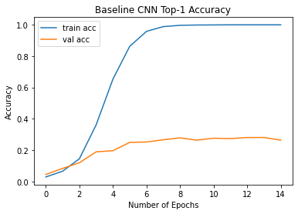
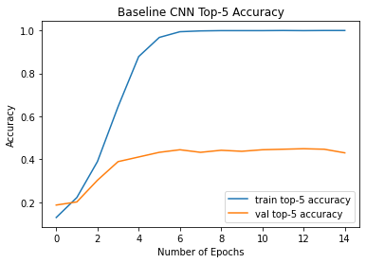
Baseline CNN Performance
 | Top-1 Accuracy | Top-5 Accuracy
Training Data | 99.8% | 99.9%
Validation Data | 28.1% | 45.0%
Testing Data | 25.7% | 42.9%
Notes:
Surprisingly high Top-1 and Top-5 Accuracies
Clearly overfit

Slide 15
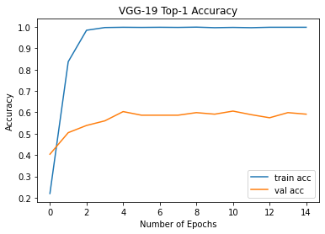
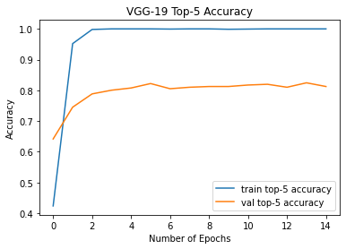
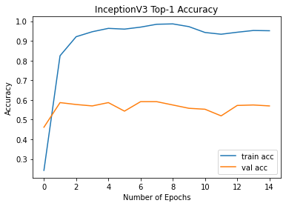
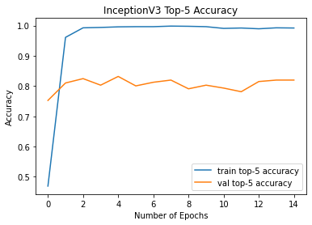
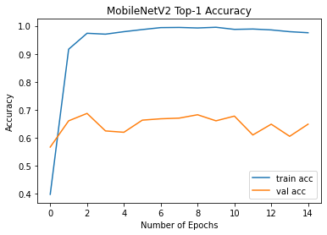
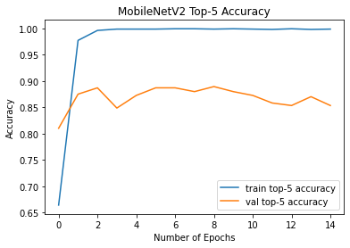
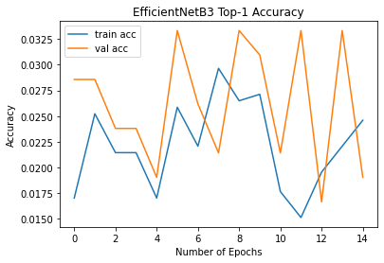
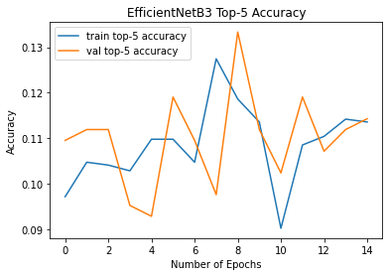
VGG-19
InceptionV3
MobileNetV2
EfficientNetB3
Notes:
Here we have our pre-trained model comparison
All models except EfficientNetB3 are overfit
Can reduce with augmented data, regularisation (early stopping, dropout layer)
We can also note that the accuracy of EfficientNetB3 is fluctuating
Not suited to the dataset
Sample size not large enough so model is just guessing

Slide 16
Pre-trained Model Performance
 | VGG-19 |  | InceptionV3 |  | MobileNetV2 |  | EfficientNetB3
 | Top-1- Acc | Top-5- Acc | Top-1- Acc | Top-5- Acc | Top-1- Acc | Top-5- Acc | Top-1- Acc | Top-5- Acc
Training Data | 99.8% | 99.9% | 96.5% | 99.6% | 97.5% | 99.9% | 2.0% | 9.8%
Val Data | 59.1% | 81.3% | 54.1% | 79.8% | 64.9% | 85.3% | 1.9% | 9.1%
Testing Data | 55.0% | 80.7% | 54.5% | 76.8% | 61.3% | 84.0% | 1.9% | 9.1%
Notes:
No data augmentation on the models, just transfer learning
MobileNet clearly the most accurate

Slide 17
Final Model
Workflow
MobileNetV2
w/ Data Augmentation
MobileNetV2
MobileNetV2
Unfrozen
MobileNetV2
Unfrozen w/
Data Augmentation
MobileNetV2
Unfrozen-Added-Layers
MobileNetV2
Unfrozen-Added-Layers w/
Data Augmentation
Notes:
Workflow to get the final model
After deciding on MobileNet, we trained three versions of it
Data aug
One with all layers unfrozen, that is training the model fully on our data
Last one like the previous model, but with some additional layers to combat overfitting (GlobalAveragePooling2D to reduce params, dropout layer (drops/ignores neurons from CNN))
*click*
- Data augmented model performed the best, so implemented data augmentation into the other two models to compare

Slide 18
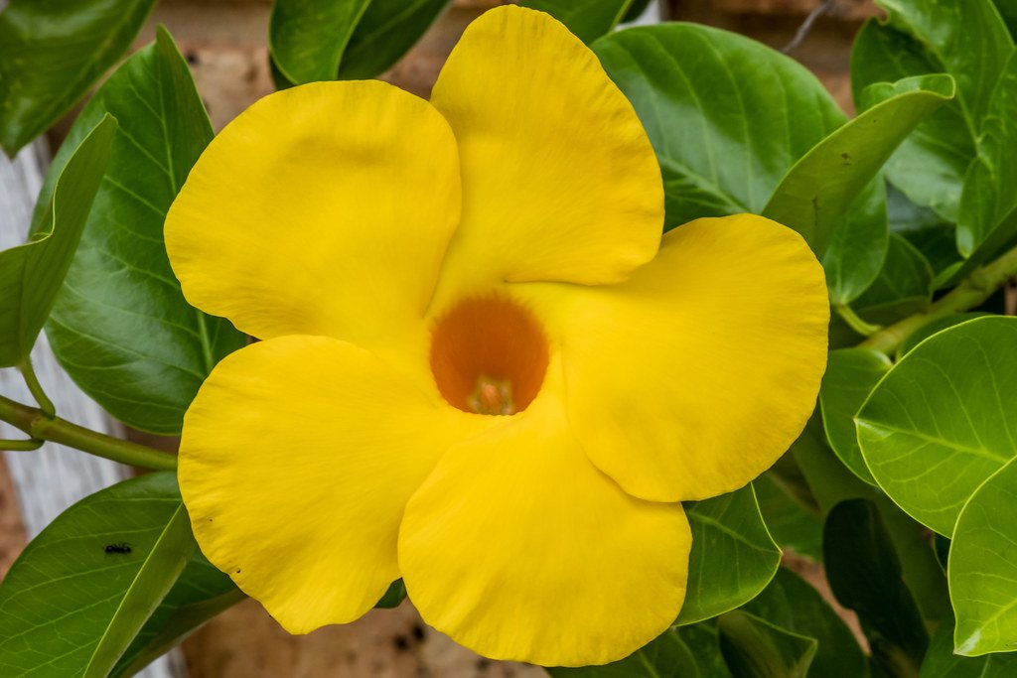
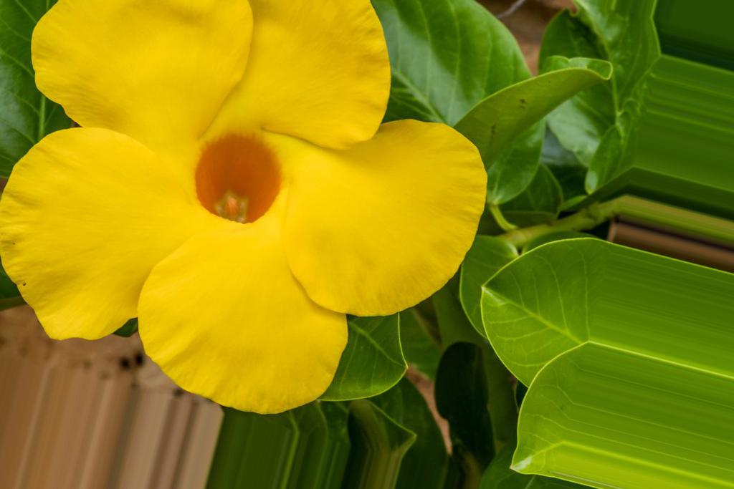
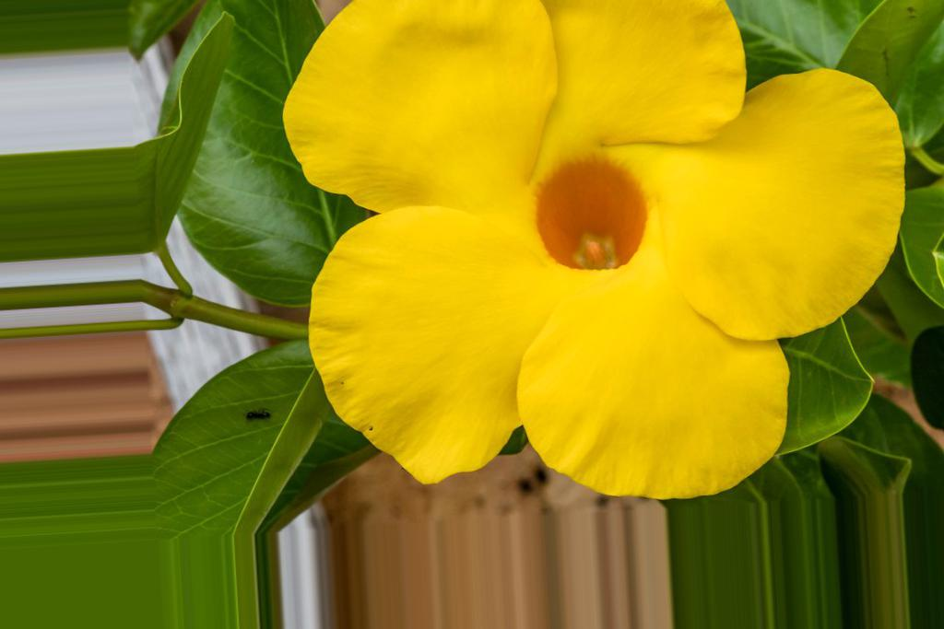
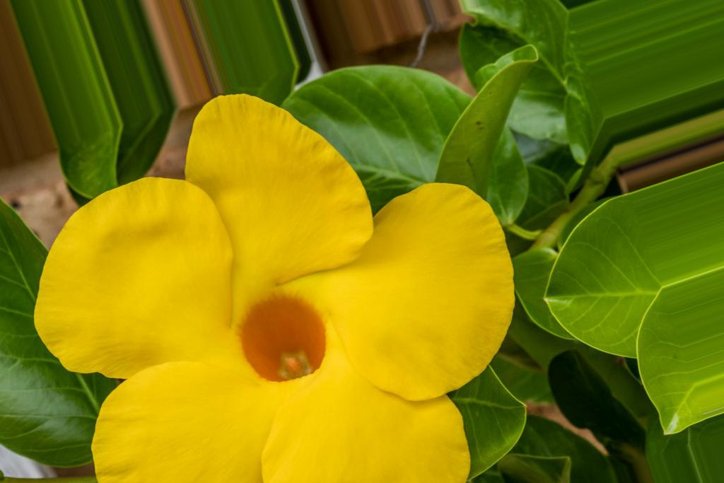
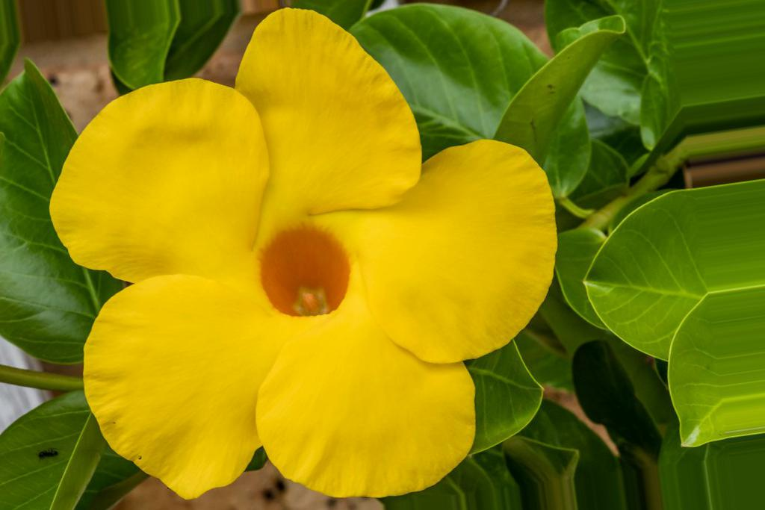
Data Augmentation
Original
train_datagen = ImageDataGenerator(
rescale = 1./255.,
rotation_range = 20,
width_shift_range = 0.2,
height_shift_range = 0.2,
shear_range = 0.2,
brightness_range = [0.8, 1.2]
)
Notes:
Data augmentation done for MobileNetV2
Typical transformations one can expect from photographs
Rotation
Shifting horizontally, vertically
Shearing
Varying the brightness of the image
Very minimal augmentations to combat overfitting
Keep in mind

Slide 19
Final Model Comparison
 | MobileNetV2 |  | MobileNetV2 (Augmented Data) |  | MobileNetV2 (Unfrozen- Augmented Data) |  | MobileNetV2 (Unfrozen- Added Layers- Augmented Data) (4)
 | Top-1- Acc | Top-5- Acc | Top-1- Acc | Top-5- Acc | Top-1- Acc | Top-5- Acc | Top-1- Acc | Top-5- Acc
Training Data | 97.5% | 99.9% | 90.2% | 99.0% | 94.3% | 99.6% | 73.3% | 92.2%
Val Data | 64.9% | 85.3% | 68.3% | 90.1% | 4.1% | 29.8% | 48.1% | 74.8%
Testing Data | 61.3% | 84.0% | 66.5% | 87.7% | 3.3% | 27.7% | 46.5% | 75.7%
Notes:
MobileNetV2 with augmented data is most-accurate model
Data augmentation improved accuracy by ~5% over original MobileNet
However, Model 4 also has potential
Huge decrease in overfitting of training data
Huge increase in testing data accuracy (by adding layers (GlobalPoolingAverage2D, Dropout))
All with minimal data augmentation

Slide 20
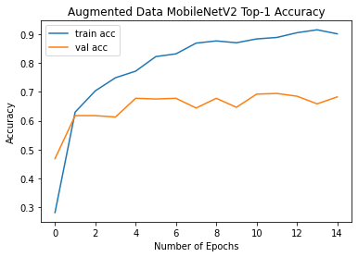
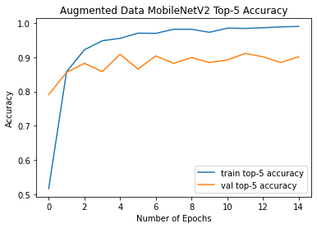
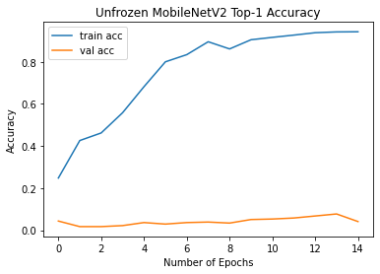
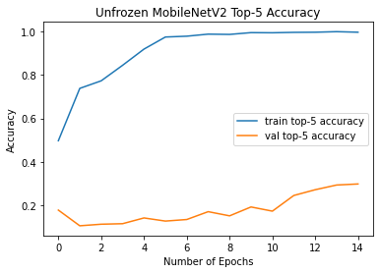
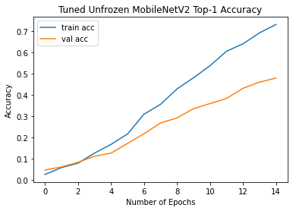
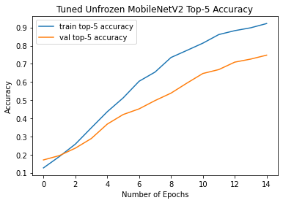
MobileNetV2
MobileNetV2
(Augmented Data)
MobileNetV2
(Unfrozen-Augmented Data)
MobileNetV2
(Unfrozen-Added-Layers-
Augmented Data)
(4)
Notes:
Furthermore, MobileNetV2(Unfrozen-Added Layers-Augmented Data) is not yet fully trained
Accuracy seems to be increasing at 15 epochs
Didn’t have time or resources to train it fully

Slide 21
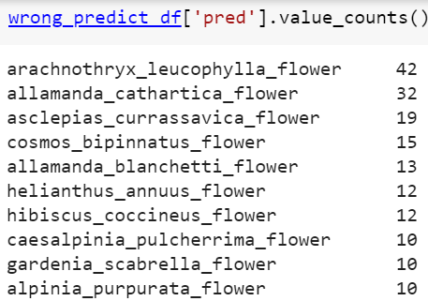
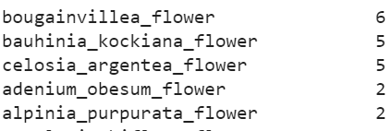
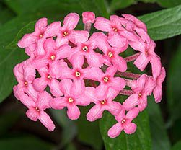



Error Analysis
Predicted
Actual
Bauhinia kockiana
Bougainvillea
Celosia Argentea
Arachnothryx leucophylla
Notes:
Arachnothryx_leucophylla_flower (42) and allamanda_cathartica_flower (32) most misclassified classes
Arachnothryx_leucophylla_flower
Similar colour
Mentioned before, problems with scale variation/zooming
Most of dataset are single flowers, these are clusters
Hard to ask users to take a photo of a single flower
Celosia odd one out but furry
CNN can detect the edges well, but within the subject itself is more difficult
Clustered flowers are always going to be difficult

Slide 22





Error Analysis
Predicted
Actual
Cascabela thevetia
Cochlospermum religiosum
Brunfelsia americana
Allamanda cathartica
Notes:
Allamanda_cathartica_flower
Similar to arachnothryx leucophylla in that there are multiple flowers in the image, although not a cluster
Allamanda cathartica training dataset has a lot of images with multiple flowers

Slide 23

Conclusion and Future Direction
MobileNetV2
Further data augmentation on pre-trained model
Further train/tune the unfrozen model
More accurate models?
Pl@ntNet 300K
Source: https://datasets-benchmarks-proceedings.neurips.cc/paper/2021/file/7e7757b1e12abcb736ab9a754ffb617a-Paper-round2.pdf
Notes:
MobileNetV2
Best-performing model
Most suited for use in a phone app
Cannot discount the use of more computationally intensive models
Classifier doesn’t have to be on the phone (database)
Pl@ntNet found several neural networks that were incredibly accurate >80% top-1 accuracy densenet201 being one
Trained on Pl@ntNet 300K, robust dataset of 300,000 images of plants, not just flowers
Highest accuracy is actually not a neural net, but a vision transformer (ViT), which seems to be very new technology, which is also be something I will be looking into

Slide 24

Thank You For Your Attention!
Notes:
With that, I have come to the end of my presentation. Thank you for your time!

